Slide 1
Applied Cryptography Vigenère cipher, block cipher, stream cipher, linear feedback shift register, autokey cipher, cryptanalysis, Kerckhoff’s principle, attack model, exhaustive search, sufficient key space principle
Liangfeng Zhang
School of Information Science and Technology
ShanghaiTech University

Slide 2
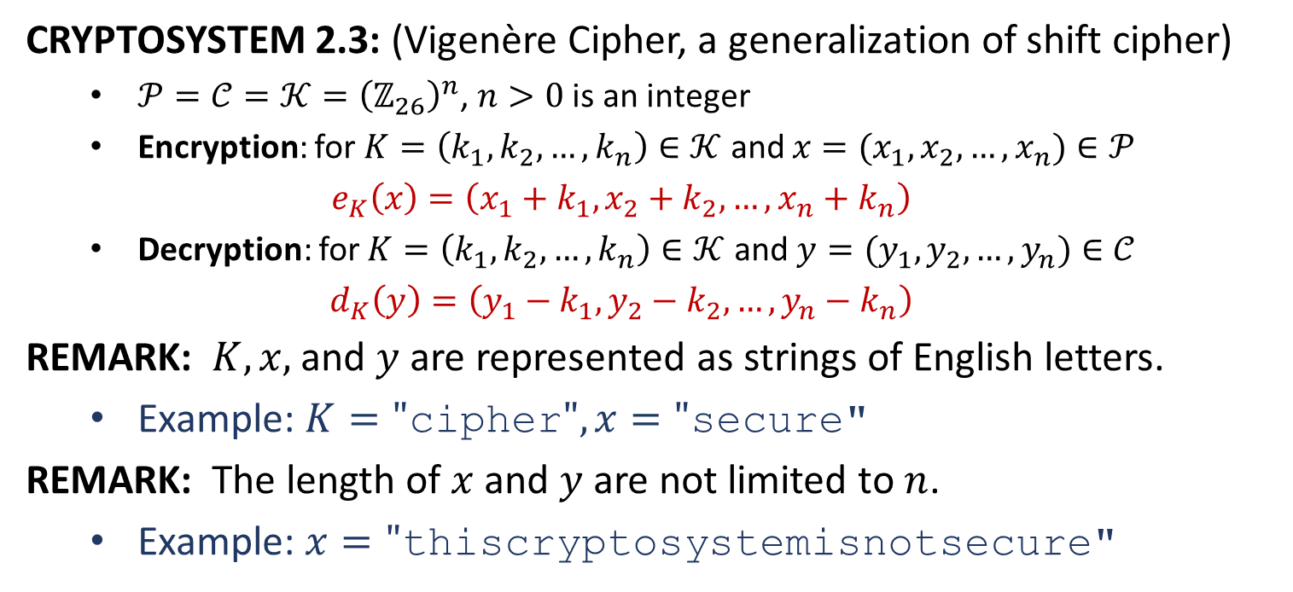
Vigenère Cipher
CRYPTOSYSTEM 2.3: (Vigenère Cipher, a generalization of shift cipher)
$𝒫=𝒞=𝒦={\left(ℤ_{26}\right)}^{n}$, $n>0$ is an integer
Encryption: for $K=\left(k_{1},k_{2},…,k_{n}\right)∈𝒦$ and $x=(x_{1},x_{2},…,x_{n})∈𝒫$
$$e_{K}\left(x\right)=\left(x_{1}+k_{1}, x_{2}+k_{2},…,x_{n}+k_{n}\right)$$
Decryption: for $K=\left(k_{1},k_{2},…,k_{n}\right)∈𝒦$ and $y=(y_{1},y_{2},…,y_{n})∈𝒞$
$$d_{K}\left(y\right)=\left(y_{1}−k_{1}, y_{2}−k_{2},…,y_{n}−k_{n}\right)$$
REMARK: $K,x,$ and $y$ are represented as strings of English letters.
Example: $K=\text{"}\text{cipher}\text{"}, x="\text{secure}\text{"}$
REMARK: The length of $x$ and $y$ are not limited to $n$.
Example: $x=\text{"}\text{thiscryptosystemisnot}\text{secure}\text{"}$

Slide 3

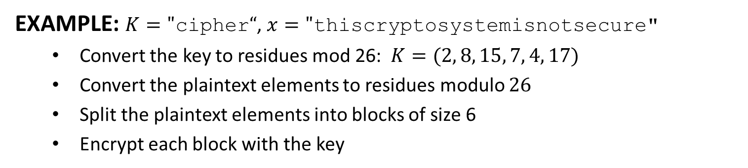
Vigenère Cipher
EXAMPLE: $K=\text{"}\text{cipher}“$, $x=\text{"}\text{thiscryptosystemisnotsecure}\text{"}$
Convert the key to residues mod 26: $K=(2, 8, 15, 7, 4, 17)$
Convert the plaintext elements to residues modulo $26$
Split the plaintext elements into blocks of size 6
Encrypt each block with the key
$y=$“VPXZGIAXIVWPUBTTMJPWIZITWZT”
t | h | i | s | c | r | y | p | t | o | s | y | s
19 | 7 | 8 | 18 | 2 | 17 | 24 | 15 | 19 | 14 | 18 | 24 | 18
2 | 8 | 15 | 7 | 4 | 17 | 2 | 8 | 15 | 7 | 4 | 17 | 2
21 | 15 | 23 | 25 | 6 | 8 | 0 | 23 | 8 | 21 | 22 | 15 | 20
V | P | X | Z | G | I | A | X | I | V | W | P | U
t | e | m | i | s | n | o | t | s | e | c | u | r | e
19 | 4 | 12 | 8 | 18 | 13 | 14 | 19 | 18 | 4 | 2 | 20 | 17 | 4
8 | 15 | 7 | 4 | 17 | 2 | 8 | 15 | 7 | 4 | 17 | 2 | 8 | 15
1 | 19 | 19 | 12 | 9 | 15 | 22 | 8 | 25 | 8 | 19 | 22 | 25 | 19
B | T | T | M | J | P | W | I | Z | I | T | W | Z | T

Slide 5
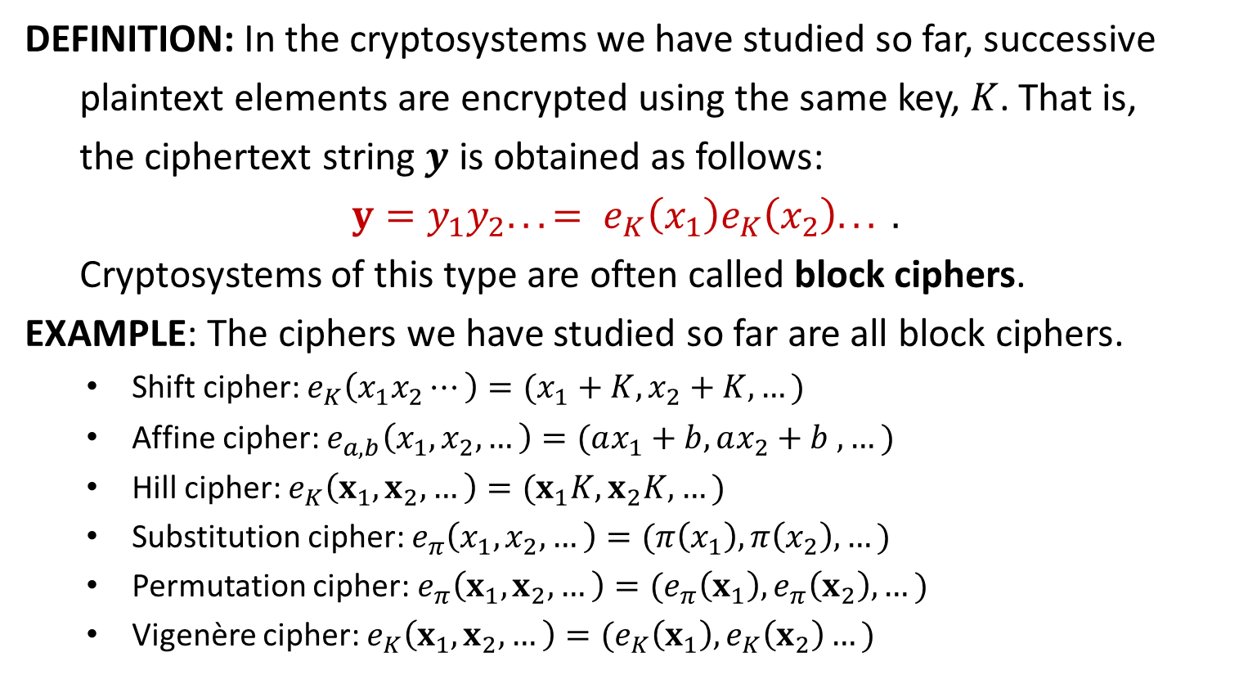
Block Cipher
DEFINITION: In the cryptosystems we have studied so far, successive
plaintext elements are encrypted using the same key, $K$. That is,
the ciphertext string $y$ is obtained as follows:
$$y=y_{1}y_{2}. . .= e_{K}\left(x_{1}\right)e_{K}\left(x_{2}\right). . . .$$
Cryptosystems of this type are often called block ciphers.
EXAMPLE: The ciphers we have studied so far are all block ciphers.
Shift cipher: $e_{K}\left(x_{1}x_{2}⋯\right)=(x_{1}+K, x_{2}+K, …)$
Affine cipher: $e_{a,b}\left(x_{1},x_{2},…\right)=(ax_{1}+b,ax_{2}+b ,…)$
Hill cipher: $e_{K}\left(x_{1},x_{2},…\right)=(x_{1}K, x_{2}K,…)$
Substitution cipher: $e_{π}\left(x_{1},x_{2},…\right)=(π\left(x_{1}\right),π\left(x_{2}\right),…)$
Permutation cipher: $e_{π}\left(x_{1},x_{2},…\right)=(e_{π}\left(x_{1}\right),e_{π}\left(x_{2}\right),…)$
Vigenère cipher: $e_{K}\left(x_{1},x_{2},…\right)=(e_{K}\left(x_{1}\right),e_{K}\left(x_{2}\right)…)$

Slide 6
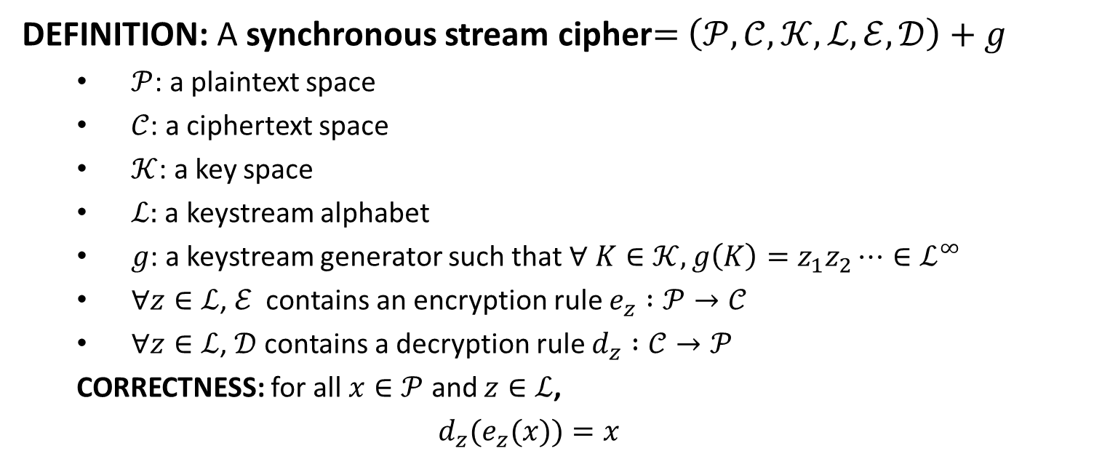
Stream Cipher
DEFINITION: A synchronous stream cipher$=$ $\left(𝒫, 𝒞,𝒦,ℒ, ℰ,𝒟\right)+$ $g$
$𝒫$: a plaintext space
$𝒞$: a ciphertext space
$𝒦$: a key space
$ℒ:$ a keystream alphabet
$g$: a keystream generator such that $∀ K∈𝒦, g\left(K\right)=z_{1}z_{2}⋯∈ℒ^{∞}$
$∀z∈ℒ$, $ℰ$ contains an encryption rule $e_{z} :𝒫→𝒞$
$∀z∈ℒ$, $𝒟$ contains a decryption rule $d_{z} :𝒞→𝒫$
CORRECTNESS: for all $x∈𝒫$ and $z∈ℒ$,
$$d_{z}(e_{z}(x))=x$$

Slide 7
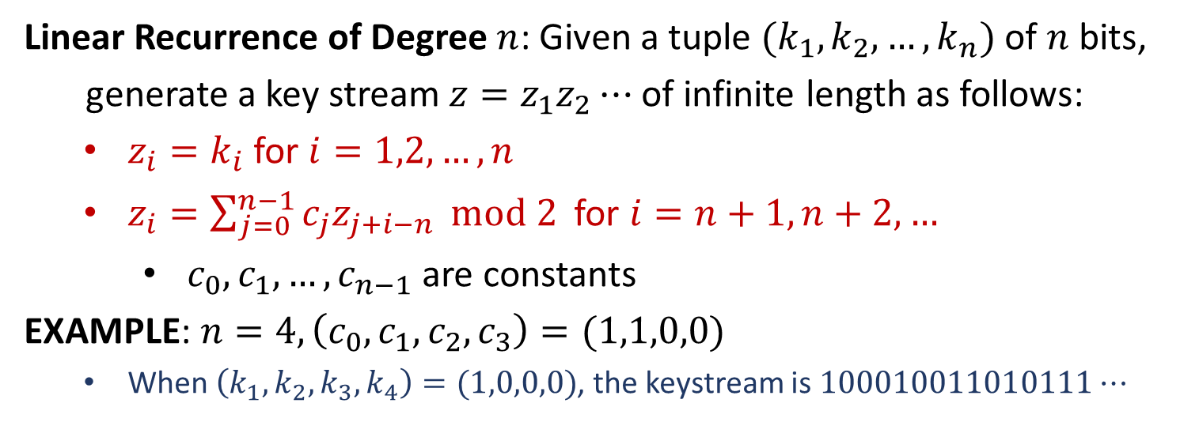
Keystream Generator
Linear Recurrence of Degree $n$: Given a tuple $(k_{1},k_{2},…,k_{n})$ of $n$ bits,
generate a key stream $z=z_{1}z_{2}⋯$ of infinite length as follows:
$z_{i}=k_{i}$ for $i=1,2,…,n$
$z_{i}=\sum_{j=0}^{n−1}{c_{j}z_{j+i−n}} mod 2$ for $i=n+1,n+2, …$
$c_{0},c_{1},…,c_{n−1}$ are constants
EXAMPLE: $n=4, \left(c_{0},c_{1},c_{2},c_{3}\right)=(1,1,0,0)$
When $\left(k_{1},k_{2},k_{3},k_{4}\right)=(1,0,0,0)$, the keystream is $100010011010111⋯$
Linear Feedback Shift Register (LFSR) for the above generator

Slide 8








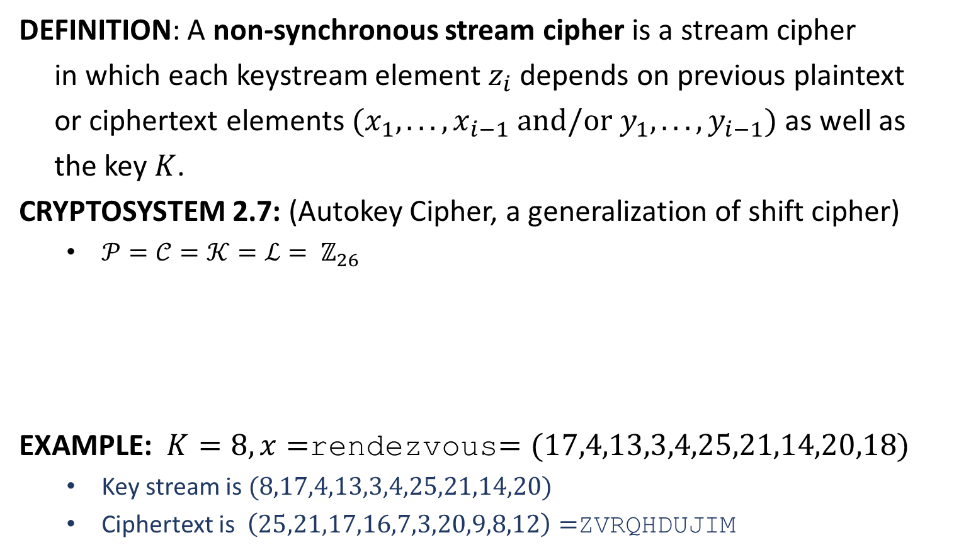














Stream Cipher
DEFINITION: A non-synchronous stream cipher is a stream cipher
in which each keystream element $z_{i}$ depends on previous plaintext
or ciphertext elements $(x_{1}, . . . , x_{i−1} \text{and}\text{/}\text{or} y_{1}, . . . , y_{i−1})$as well as
the key $K$.
CRYPTOSYSTEM 2.7: (Autokey Cipher, a generalization of shift cipher)
$𝒫=𝒞=𝒦=ℒ= ℤ_{26}$
EXAMPLE: $K=8, x=$rendezvous$=(17,4,13,3,4,25,21,14,20,18)$
Key stream is $(8,17,4,13,3,4,25,21,14,20)$
Ciphertext is $\left(25,21,17,16,7,3,20,9,8,12\right)=$ZVRQHDUJIM
plaintext
$$x_{1}$$
$$x_{2}$$
$$x_{3}$$
$$x_{4}$$
$$x_{5}$$
$$⋯$$
keystream
$$K$$
$$x_{1}$$
$$x_{2}$$
$$x_{3}$$
$$x_{4}$$
$$⋯$$
ciphertext
$$y_{1}=x_{1}+K$$
$${y_{2}=x}_{2}+x_{1}$$
$${y_{3}=x}_{3}+x_{2}$$
$${y_{4}=x}_{4}+x_{3}$$
$${y_{5}=x}_{5}+x_{4}$$
$$⋯$$
plaintext
$$x_{1}=y_{1}−K$$
$$x_{2}=y_{2}−x_{1}$$
$$x_{3}=y_{3}−x_{2}$$
$$x_{4}=y_{4}−x_{3}$$
$$x_{5}=y_{5}−x_{4}$$
$$⋯$$

Slide 10
Cryptanalysis
DEFINITION: Cryptanalysis is the study of mathematical techniques for
attempting to defeat cryptographic techniques and/or information
systems security. This includes the process of looking for errors or
weaknesses in the implementation of an algorithm or of the
algorithm itself. --CNSSI No. 4009
Cryptology = Cryptography + Cryptanalysis
Kerckhoff’s Principle: The cipher method must not be required to be
secret, and it must be able to fall into the hands of the enemy
without inconvenience. --Introduction to Modern Cryptography
When the adversary is attacking, it knows which cryptosystem is being used.
The security of a cryptosystem should solely rely on the secrecy of the key.
By Kerckhoff, 19th century

Slide 11
Attack Model and Objective
DEFINITION: Attack model specifies the information available to the
adversary when he mounts the attack.
Ciphertext-Only Attack (COA): The adversary has a string of ciphertext.
Known Plaintext Attack (KPA): The adversary has a string of plaintext and the corresponding ciphertext.
Chosen Plaintext Attack (CPA): The adversary has temporary access to the encryption machinery.
Chosen Ciphertext Attack (CCA): The adversary has temporary access to the decryption machinery.
Adversary’s Objectives: There are many. It may have one or more.
Determine the key that was used in encryption
Determine the plaintext for a given ciphertext

Slide 13


Cryptanalysis of Shift Cipher
EXAMPLE: JBCRCLQRWCRVNBJENBWRWN is a ciphertext under the
shift cipher. Determine the key $K$.
$K=9;$ the plaintext is a stitch in time saves nine
$$K$$ | JBCRCLQRWCRVNBJENBWRWN
0 | jbcrclqrwcrvnbjenbwrwn
1 | iabqbkpqvbqumaidmavqvm
2 | hzapajopuaptlzhclzupul
3 | gyzozinotzoskygbkytotk
4 | fxynyhmnsynrjxfajxsnsj
5 | ewxmxglmrxmqiweziwrmri
6 | dvwlwfklqwlphvdyhvqlqh
7 | cuvkvejkpvkogucxgupkpg
8 | btujudijoujnftbwftojof
9 | astitchintimesavesnine

Slide 14
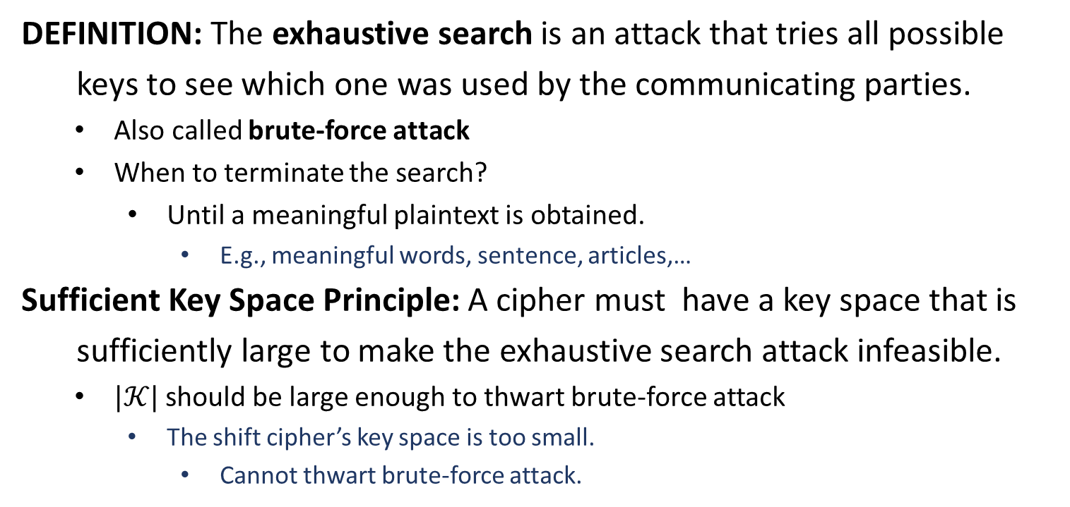
Exhaustive Search
DEFINITION: The exhaustive search is an attack that tries all possible
keys to see which one was used by the communicating parties.
Also called brute-force attack
When to terminate the search?
Until a meaningful plaintext is obtained.
E.g., meaningful words, sentence, articles,…
Sufficient Key Space Principle: A cipher must have a key space that is
sufficiently large to make the exhaustive search attack infeasible.
$|𝒦|$ should be large enough to thwart brute-force attack
The shift cipher’s key space is too small.
Cannot thwart brute-force attack.

Slide 16
Probabilities of English Letters
E: occurs with probability about 0.120
T, A,O, I, N, S, H, R: occurs with probability between 0.06 and 0.09
D, L: occurs with probability around 0.04
C,U,M,W, F, G,Y, P, B: occurs with probability between 0.015 and 0.028
V, K, J, X,Q,Z: occurs with probability less than 0.01.

Slide 17
Digrams and Trigrams
The 30 most common digrams (in decreasing order):
TH, HE, IN, ER, AN, RE, ED, ON, ES, ST,
EN, AT, TO, NT, HA, ND, OU, EA, NG, AS,
OR, TI, IS, ET, IT, AR, TE, SE, HI, OF.
The 12 most common trigrams:
THE, ING, AND, HER, ERE, ENT,
THA, NTH, WAS, ETH, FOR, DTH.

Slide 19
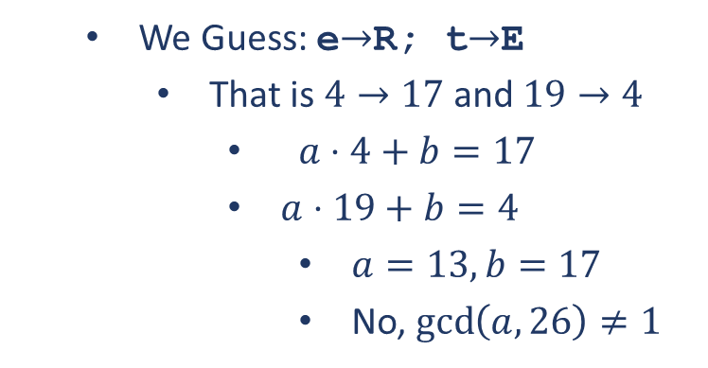

Cryptanalysis of the Affine Cipher
EXAMPLE: Decrypt the following ciphertext in the affine cipher:
FMXVEDKAPHFERBNDKRXRSREFMORUD
SDKDVSHVUFEDKAPRKDLYEVLRHHRH
letter | A | B | C | D | E | F | G | H | I | J | K | L | M
No. | 2 | 1 | 0 | 7 | 5 | 4 | 0 | 5 | 0 | 0 | 5 | 2 | 2
letter | N | O | P | Q | R | S | T | U | V | W | X | Y | Z
No. | 1 | 1 | 2 | 0 | 8 | 3 | 0 | 2 | 4 | 0 | 2 | 1 | 0
We Guess: e$→$R; t$→$D
That is $4→17$ and $19→3$
$a⋅4+b=17$
$a⋅19+b=3$
$a=6, b=19$
No, $\gcd\left(a,26\right)≠1$
We Guess: e$→$R; t$→$E
That is $4→17$ and $19→4$
$a⋅4+b=17$
$a⋅19+b=4$
$a=13, b=17$
No, $\gcd\left(a,26\right)≠1$

Slide 20
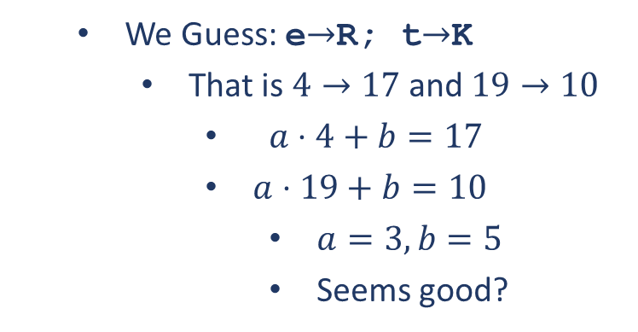
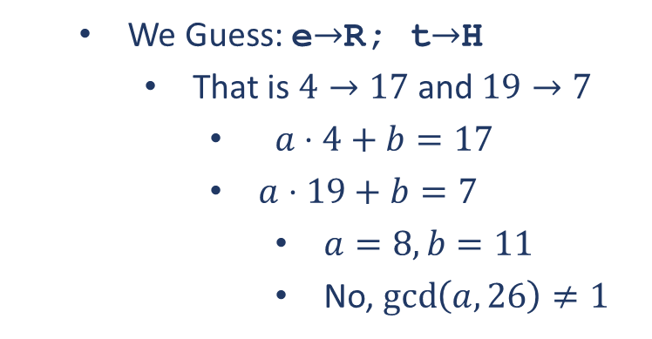
Cryptanalysis of the Affine Cipher
EXAMPLE: Decrypt the following ciphertext in the affine cipher:
FMXVEDKAPHFERBNDKRXRSREFMORUD
SDKDVSHVUFEDKAPRKDLYEVLRHHRH
letter | A | B | C | D | E | F | G | H | I | J | K | L | M
No. | 2 | 1 | 0 | 7 | 5 | 4 | 0 | 5 | 0 | 0 | 5 | 2 | 2
letter | N | O | P | Q | R | S | T | U | V | W | X | Y | Z
No. | 1 | 1 | 2 | 0 | 8 | 3 | 0 | 2 | 4 | 0 | 2 | 1 | 0
We Guess: e$→$R; t$→$H
That is $4→17$ and $19→7$
$a⋅4+b=17$
$a⋅19+b=7$
$a=8, b=11$
No, $\gcd\left(a,26\right)≠1$
We Guess: e$→$R; t$→$K
That is $4→17$ and $19→10$
$a⋅4+b=17$
$a⋅19+b=10$
$a=3, b=5$
Seems good?

Slide 21
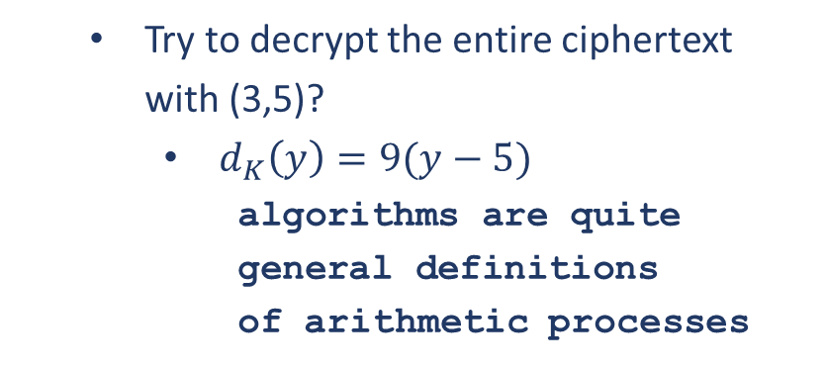
Cryptanalysis of the Affine Cipher
EXAMPLE: Decrypt the following ciphertext in the affine cipher:
FMXVEDKAPHFERBNDKRXRSREFMORUD
SDKDVSHVUFEDKAPRKDLYEVLRHHRH
letter | A | B | C | D | E | F | G | H | I | J | K | L | M
No. | 2 | 1 | 0 | 7 | 5 | 4 | 0 | 5 | 0 | 0 | 5 | 2 | 2
letter | N | O | P | Q | R | S | T | U | V | W | X | Y | Z
No. | 1 | 1 | 2 | 0 | 8 | 3 | 0 | 2 | 4 | 0 | 2 | 1 | 0
Try to decrypt the entire ciphertext with (3,5)?
$d_{K}\left(y\right)=9(y−5)$
algorithms are quite
general definitions
of arithmetic processes
We Guess: e$→$R; t$→$K
That is $4→17$ and $19→10$
$a⋅4+b=17$
$a⋅19+b=10$
$a=3, b=5$
Seems good?
√ Key is correct!

